Slide 1
Automated Domestic Hydroponic Cabinets.
Team MATERIA
Team Members-
18BCE0096, Harshvardhan Singh
18BCE0096, Lakshya Mishra
18BCE2522, Shashank Shukla

Slide 2
Introduction
Agriculture is the heart of India's economic activity and our experience during the last 60 years has demonstrated the strong relationship between agricultural growth and economic wealth.
If India want to become powerful economically in the world, our agricultural productivity should be equal to those countries, which are currently rated as economic power of the world.
Cultivation, adding up to an important aspect in GDP (Gross Domestic Produce), has been affected tremendously over the past few decades due to the use of chemicals. Due to rapid urbanization and industrialization, arable land under cultivation is decreasing enormously.
Organic farming, being the need of the hour, is opted as one of the widely chosen methodology to overcome the prevailing problem in cultivation.
With an expanding population and changing dynamics in global food markets, it is important to find solutions for more resilient food production methods closer to urban environments. Recently, vertical farming systems have emerged as a potential solution for urban farming. However, although there is an increasing body of literature reviewing the potential of urban and vertical farming systems, only a limited number of studies have reviewed the sustainability of these systems.

Slide 3
Advancements in agriculture have proven to serve the cultivators in a number of ways. To bring in another technological advancement by breaking all barriers, for organic farming is the Hydroponics where consumption of space and water are way too minimal. Hydroponics is a method of growing plants purely using water and nutrients, without soil.
The automated hydroponic farming is made to support non-professional farmers, city people who have limited knowledge in farming and people who are interested in doing vertical planting in very small areas in the city such as building tops, balconies of small rooms in high-rise buildings, and in small office spaces.
The significant decrease in agricultural land and the rapid development of hydroponic system technology such as Nutrient Film Technique (NFT), have brought huge challenge to farmers. This hydroponic system requires special attention to several parameters such as the water temperature, water level, acidity (pH), and the concentration of the nutrient (EC/PPM).
The goal of this project is to design and construct a hydroponic system which is fully automatic that can be integrated into the home agricultural curriculum. Hydroponic cultivation offers many focal points when contrasted with regular cultivation. One of the principle points of interest is that products can be developed in spots with infertile or sullied arrive. Hydroponically developed plants are too more impervious to water with a high salt substance. Another advantage incorporates not having creepy crawlies, creatures, and infections for example, growths effectively exhibit in the developing medium.

Slide 4
Abstract
Hydroponic farming is the need of the hour because of decreasing cultivation land area and increasing population. This type of farming should be highly promoted beacuse of its sustainability.
In pandemics like covid, people can opt this type of farming in their homes beacuse it requires small area to setup and continue. With growing technology, automated hydroponic farming is quite practical. In this project, we proposed a mathod and design for automated hydroponic farming for domestic use.
Various cabinets are maintained to harness full potential of this method. Cabinets are perfect for maintaining separate required conditions for such farming and are easily movable as well as convertable.

Slide 5
Literature Review:
1) Integrating Scheduled Hydroponic System-
The proposed hydroponic system is built upon the concepts of embedded system. The system facilitates the growth of multiple crops under a single controller. Necessary supplements for the crops are provided based on the inputs obtained from the pH sensor and the water level sensor used.
The water and nutrient supply to the different varieties of crop is controlled and monitored at regular time intervals. An efficient algorithm has been proposed for controlling all the functionalities. Automation of the hydroponic system improves the efficiency and reduces manual work.
The proposed hydroponic system hence implements the integration of different varieties of crops. The short comings of the existing system like growth of a single type of crop in the entire system have been overcome. A methodological approach has been taken forth to regulate the working of the system.

Slide 6
2) Nutrient Film Technique (NFT) Hydroponic Monitoring System Based on Wireless Sensor Network-
This system is used to solve the problem in the real time monitoring lettuce cultivation hydroponic NFT. The method in this system contains communication, planning, modelling, construction, and socialization.
The result of experiment shows that pH sensor has an error level of difference is 0.4. There is an error of sensor Analog Electrical Conductivity Meter, that is 5.1 ms/cm. Monitoring System for Lettuce Cultivation Hydroponic Outdoor Type Nutrient Film Technique using Wireless Sensor Network is needed by the farmer to prevent crop failure and easier to monitor parameter hydroponic cultivation real time. So, the farmer doesnt need to go to green house one by one in different area. It makes monitoring process get easier than before.
The result of pH sensor and EC sensor are used to know accuracy of each sensor, is good or not to measurement. The next research for this system can be developed on the part of amount green house or nutrition tank more than two. So, the other plants in different green house can communicate each other and know the condition itself.

Slide 7
3) Smart hydroponic farming with IoT-based climate and nutrient manipulation system-
In this study an automatic computer-controlled climate and nutrient manipulation system will be proposed. Manipulation will be based on monitoring carried out by a number of sensors that will be processed by computers in an IoT-based system.
Automation is done using NodeMCU as a controller and some sensors are used such as water flow, water level, pH meter, EC, humidity meter and lux meter sensor. The proposed architectural design will require a greenhouse where the environment inside the building will be manipulated.
Parameters that will be manipulated includes amount of sunlight needed, how often LED lights are used, humidity, and aeration. Based on this system design, it shown that it is possible to create fully automatic hydroponic agriculture by manipulating few parameters that need to be controlled.

Slide 8
4) Automatic Control and Management System for Tropical Hydroponic Cultivation-
This paper proposes automatic control and management system for tropical hydroponic cultivation. The system aims to reduce information exchange of multisensory data fusion within the wireless sensor network by grouping the sensors to decide the data fusion results.
It can control water level, humidity, and temperature as grower setting automatically. It also sends sensor data and status, collects pH and EC values of individual nutrient solution tank, and sends notification via Android mobile application. The data history is available on web application. This also helps to monitor, manage data, and setting online.
The system can control water level, humidity, and temperature as grower setting both automatically or manually.

Slide 9
5) Environmental Assessment of an Urban Vertical Hydroponic Farming System in Sweden-
The aim of this article is to understand the environmental impacts of vertical hydroponic farming in urban environments applied to a case study vertical hydroponic farm in Stockholm, Sweden.
This was carried out by evaluating environmental performance using a life cycle perspective to assess the environmental impacts and comparing to potential scenarios for improvement options. The results suggest that important aspects for the vertical hydroponic system include the growing medium, pots, electricity demand, the transportation of raw materials and product deliveries. Replacing conventional gardening soil as the growing medium with coir also leads to large environmental impact reductions.
However, in order to further reduce the impacts from the system, more resource-efficient steps will be needed to improve impacts from electricity demand, and there is potential to develop more symbiotic exchanges to employ urban wastes and by-products.

Slide 10
6) Hydroponic Smart Farming Using Cyber Physical Social System with Telegram Messenger-
In the Cyber Physical Social System (CPSS), collaborative work between hydroponic farmers is now possible. With this new concept, hydroponic smart farming system that can be monitored online via Telegram Messenger is developed.
The design that is created can monitor important parameters in the hydroponics system, such as light intensity, room temperature, humidity, pH, nutrient temperature, and Electrical Conductivity (EC). The prototype is designed using Raspberry Pi 3 that connects directly with sensors such as DHT11 module, LDR, pH sensor module, and EC sensor. Telegram BOT that allows to monitor sensors online via Telegram is also made. With the integration of the Physical System (Raspberry Pi, sensor) and Social System (Telegram Messenger) connected online via internet or cyber, the hydroponic system monitoring becomes more flexible.
With the monitoring system through this CPSS, it allows hydroponic farmers wherever and whenever to know the condition of plants in real-time. Telegram-Bot made python based using the Telegram Messenger platform.

Slide 11
7) An AI Based System Design to Develop and Monitor a Hydroponic Farm (Hydroponic Farming for Smart City)-
In this paper, authors proposed to prepare an Artificial Intelligent system to do hydroponic farming in closed environment which will automatically deliver mix of water and nutrient solution along with light, directly to the roots of plants using sensors.
For experiment they have used Tomato F1 Hybrid seed. This system will help in calculating the average growth rate ratio for Tomato F1 Hybrid Suhyana seed that are grown hydroponically and would compare it with soil grown plants. This paper shows how automatic hydroponic system can be implemented using Raspberry Pi 3 with Micro controller to control and monitor all the sensors connected to it.
This system is implemented in closed environment for automating crop plantation. It describes how the mix of water, Light and nutrient solution will be automatically delivered to the roots of tomato plants by maintaining the pH level of the nutrient solution and temperature.

Slide 12
8) Applied Internet of Thing for Smart Hydroponic Farming Ecosystem (HFE)-
This paper proposes a Hydroponic Farming Ecosystem (HFE) that uses IoT devices to monitor humidity, nutrient solution temperature, air temperature, PH and Electrical Conductivity (EC).
To make the system easy to control and easy to use, they have used an android application to control IoT devices in the HFE and alarm users when their farm is in an abnormal situation. This paper applies the Internet of Things for Smart Hydroponic Farming Ecosystem (HFE) and automates hydroponic farming.
After the experiments conducted they showed this system could work whether using it in automatic or manual mode. Further work is applying the system in a symmetrical plantation to check the accuracy of the HFE across multiple farms in the same area; and verify that controlling via mobile application works correctly.
In this report, source of light energy lags, they have not mentioned anything about light.

Slide 13
9) Hommons: Hydroponic Management and Monitoring System for an IOT Based NFT Farm Using Web Technology-
In this paper, a hydroponic monitoring and automation system is proposed that can be monitored using sensors connected to the Arduino Uno microcontroller, Wi-Fi module ESP8266 and Raspberry Pi 2 Model B microcomputers as the webserver with the concept of Internet of Things, in which each block hydroponic farming can communicate with the webserver.
Web is used as the interface of the system that allows user to monitor and control the NFT hydroponic farming. The NFT hydroponic web interface management systems uses a responsive web framework, such as Bootstrap for the front-end, JQuery and JavaScript libraries.
The result shows that this system helps farmers to increase the effectivity and efficiency on monitoring and controlling NFT Hydroponic Farm. The future work of this research is to collect environmental data, which is obtained from sensors and implanting an artificial intelligence that makes the Hydroponic Management and Monitoring System can run automatically.

Slide 14
10) Hydroponic Nutrient Control System based on Internet of Things and KNearest Neighbors-
In this research, authors propose a system that measures pH, TDS, and nutrient temperature values in the nutrient film technique (NFT) technique using a couple of sensors. They use lettuce as an object of experiment and apply the KNN (k-Nearest Neighbor) algorithm to predict the classification of nutrient conditions.
The result of prediction is used to provide a command to the microcontroller to turn on or off the nutrition controller actuators simultaneously at a time. The experiment result shows that the proposed KNN algorithm achieves 93.3% accuracy when k=5.
The evaluated system shows that KNN successful classifies the nutrient condition with several k values. The classification result output can be used in a realtime condition and used as a command to the actuator module. The actuator also can turn on or off the nutrition controller simultaneously at a time according to the label that is classified.

Slide 15
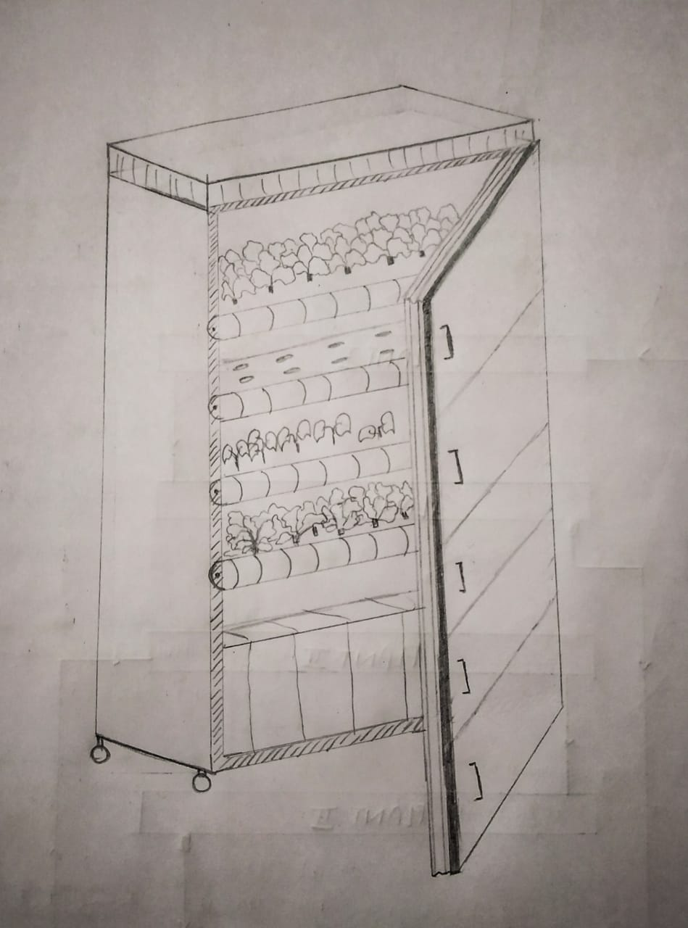
Design

Slide 16
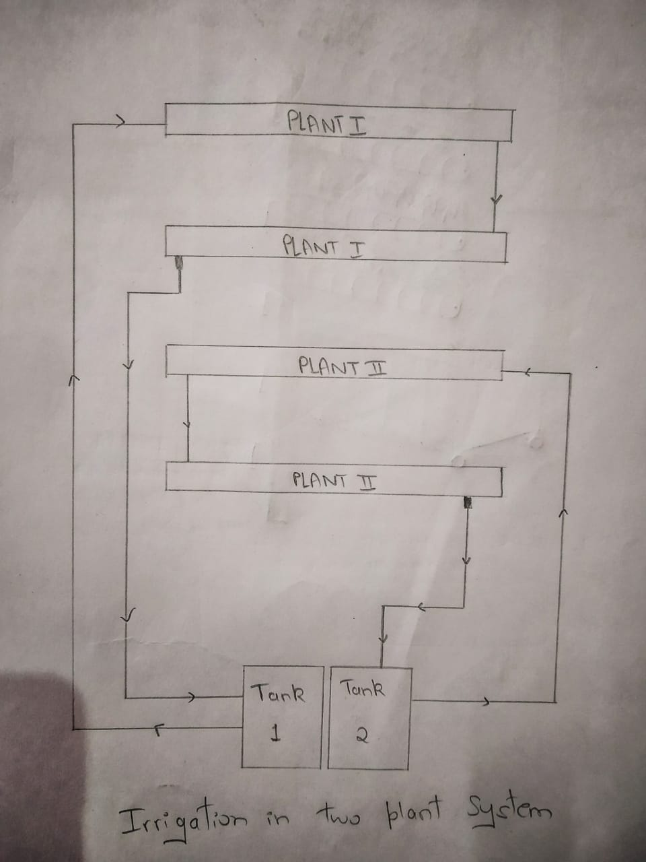
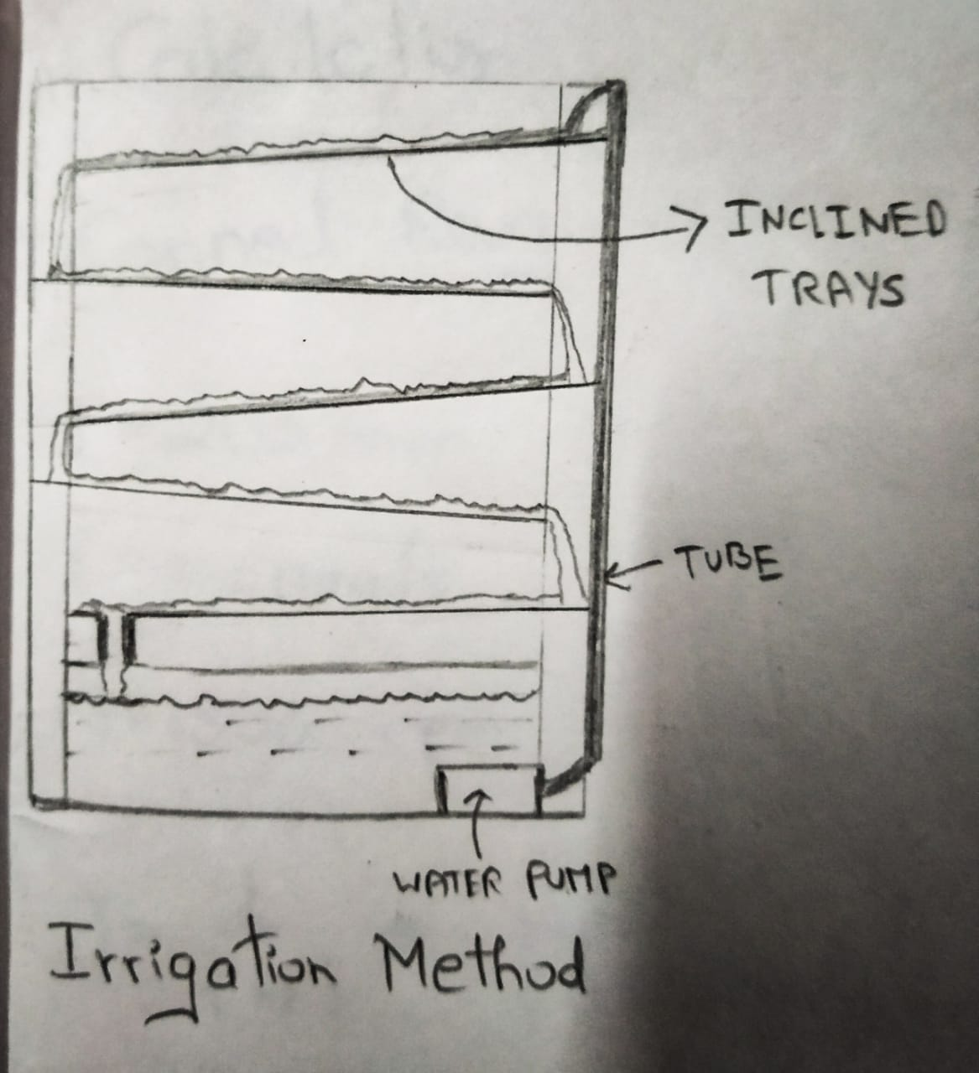

Slide 17
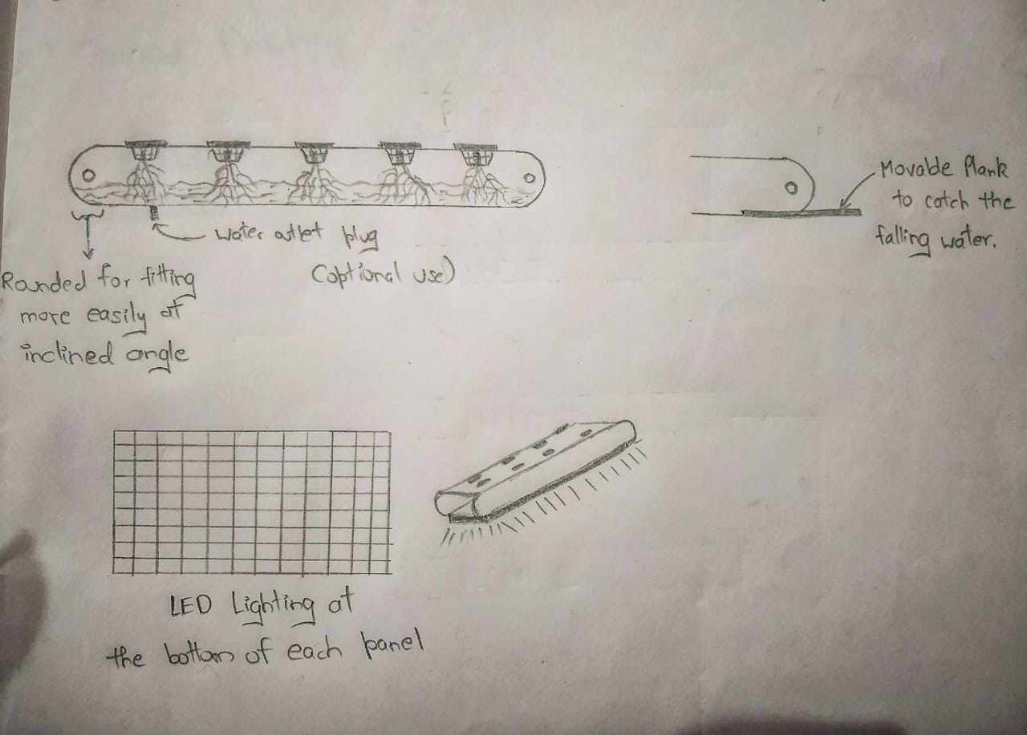
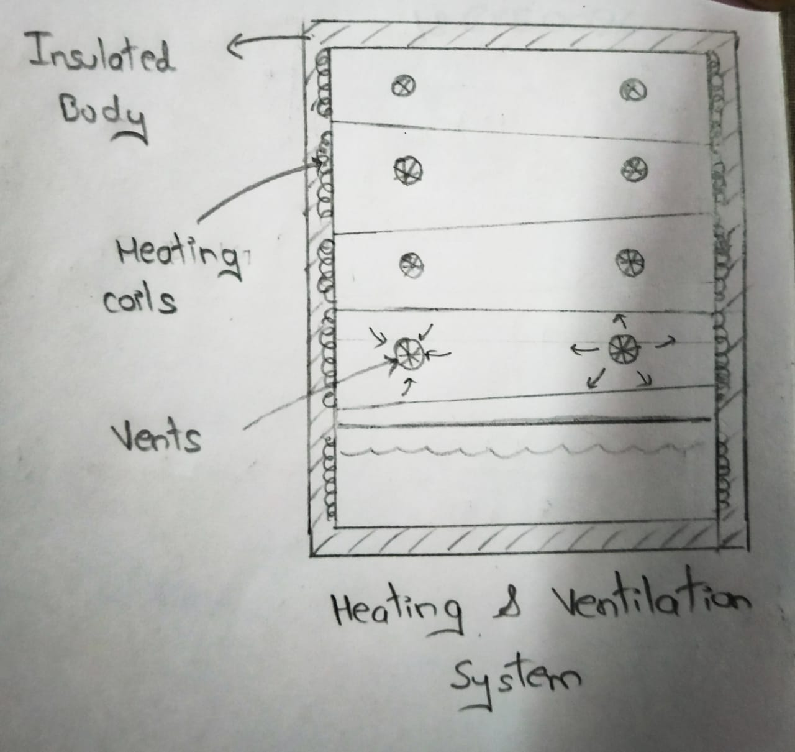

Slide 18
USP(Unique Selling Preposition)
Setup is easy and highly affordable.
Cabinets can be easily added or removed.
Our setup is highly home oriented unlike shown in literature review which are farm or research oriented. Hence it is useful in pandemic.
Since, its covered from all sides hence safe.
Season independent crops can be grown.
Different season plants can be grown in different cabinet.(air tight)
Fully automated.
Easily movable.

Slide 19
Validated Leaning

Slide 20
Cost Analysis

Slide 21
Business Model

Slide 22
Marketing Techniques

Slide 23
CAD Model-

Slide 24
Conclusion

Slide 25
Reference

